Slide 1


Global Climate Change
Week 2, Questions and Answers
Dr Thomas Bannan

Slide 2

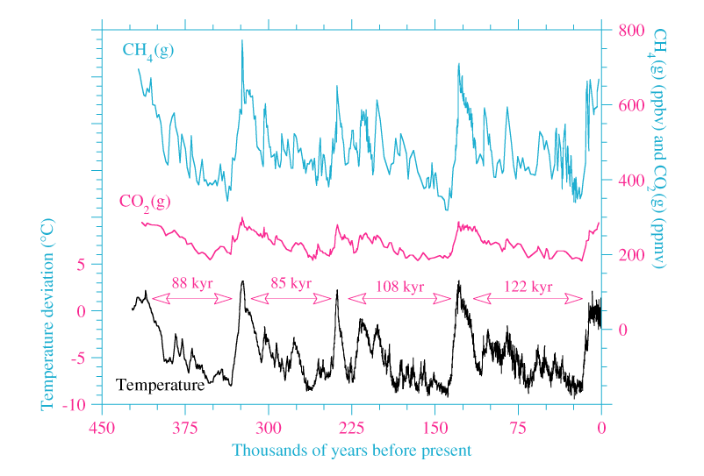
Class Discussion (5 mins)
In past climate records, does temperature change before or after CO₂?
What starts the change first: orbital changes, temperature, or CO₂?
From prior knowledge what drives these observed changes in CO₂?

Slide 3

Answer
1. Orbital changes start the process
Milankovitch cycles change how solar energy is distributed across Earth, especially at high latitudes.
They affect seasons and ice sheets, not CO₂ directly.
2. Temperature usually changes first
Orbital changes → warming or cooling
Warming → ice melts
Cooling → ice grows
Ice core data show that temperature often leads CO₂ by a few hundred years during ice age cycles.
3. CO₂ responds, in large parts through the oceans
The oceans store far more carbon than the atmosphere.
Cold oceans absorb more CO₂
Warm oceans release CO₂
So when climate warms, CO₂ rises; when climate cools, CO₂ falls.
4. CO₂ then acts as a feedback
Once CO₂ increases, it amplifies warming through the greenhouse effect.
This helps turn small orbital changes into large global temperature changes.
Overall:
Orbital changes trigger climate change → temperature changes first → CO₂ follows and strengthens the change.

Slide 4
Q1.
What is the difference between natural variability and human-induced climate change? How do we separate their effects in climate studies?

Slide 5
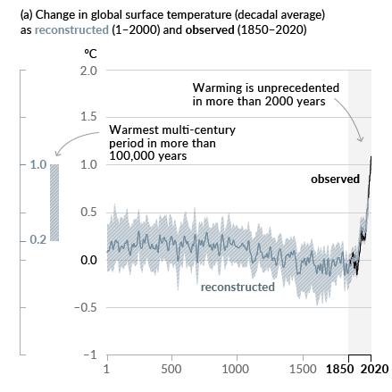
Q1. Answer
What is the difference between natural variability and human-induced climate change? How do we separate their effects in climate studies?
Natural variability refers to changes in the climate system caused by processes such as orbital variations, ocean circulation, solar activity, and volcanic eruptions.
Human-induced climate change, is driven from activities like burning fossil fuels, deforestation, and industrial emissions that alter greenhouse gas concentrations.
Observational records, including temperature and precipitation data, can be compared with global climate models (week 7) to separate natural variability from anthropogenic effects.
Fingerprinting techniques are used to identify patterns specific to human influence, such as stratospheric cooling combined with surface warming, which further demonstrates that humans are driving the change that is plotted on the right-hand figure.
Proxy records and historical data (largely from ice core data, more in week 5) provides essential context for understanding natural variability and what would be happening without our influence

Slide 6
Q2.
Which components of the Earth system interact to produce natural climate variability?

Slide 7
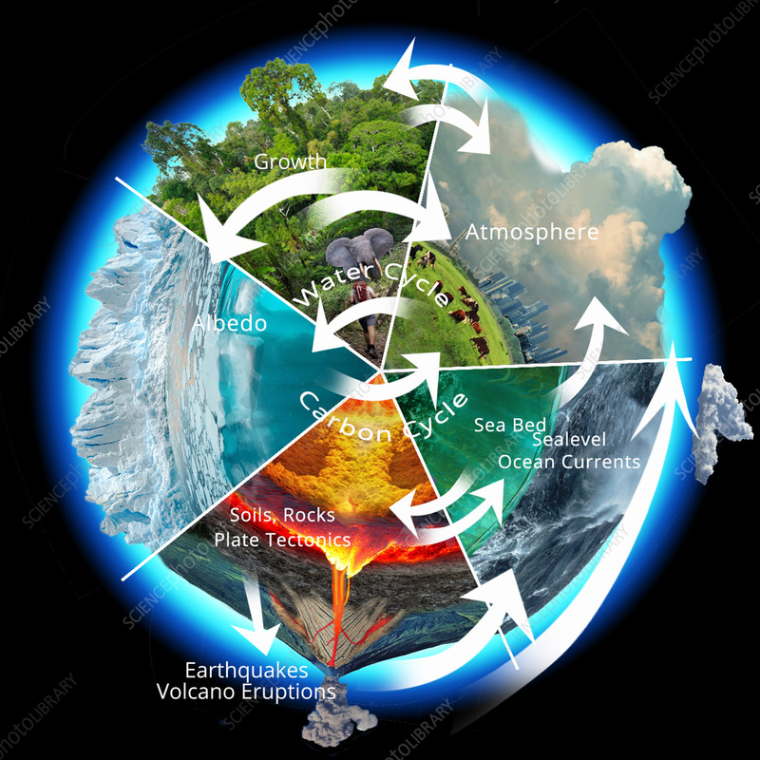
Q2 Answer
Which components of the Earth system interact to produce natural climate variability?
Some of the key components of the earth system to produce Natural climate variability are listed below. Note that these don’t just work in isolation, instead they are often driven by interactions between these components, operating over timescales from years (e.g. ENSO) to hundreds of thousands of years (e.g. orbital cycles).
The atmosphere
Controls temperature, winds, clouds, and greenhouse gases, responding rapidly to changes in energy input.
The oceans
Store and redistribute heat and carbon around the planet. Changes in ocean circulation (e.g. ENSO) strongly influence global and regional climate.
The cryosphere (ice sheets, glaciers, sea ice)
Affects climate through surface albedo (reflection of sunlight) and interactions with temperature and sea level. There are some important feedback mechanisms here to explore.
The Sun–Earth system
Variations in Earth’s orbit and tilt (Milankovitch cycles) and changes in solar output alter the amount and distribution of incoming solar radiation. Solar output changes can also be considered.
The biosphere
Vegetation and ecosystems influence carbon storage, surface reflectivity, and exchanges of gases with the atmosphere.

Slide 8
Q3.
How can volcanic eruptions serve as a "natural experiment" for studying climate response to aerosol forcing?

Slide 9
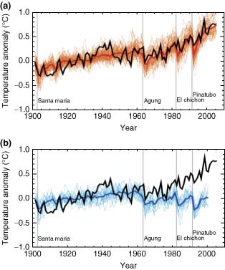
Q3. Answer
How can volcanic eruptions serve as a "natural experiment" for studying climate response to aerosol forcing?
Volcanic eruptions inject large quantities of sulphate aerosols into the stratosphere, which temporarily cool the Earth's surface.
These events allow scientists to observe short-term climatic responses to changes in radiative forcing.
They provide real-world data to test and validate climate model predictions about aerosol impacts.
Eruptions highlight the importance of aerosol-cloud interactions in shaping climate responses.
Case studies, such as the eruption of Mount Pinatubo in 1991, offer valuable insights into the climate’s sensitivity to aerosol forcing, which is clearly shown in the figure to the right.

Slide 10
Q4.
How do scientists use ice cores to reconstruct long-term natural climate variability?

Slide 11
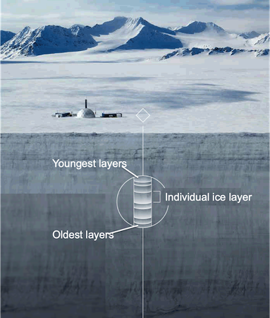
Q4. Answer
How do scientists use ice cores to reconstruct long-term natural climate variability?
Ice cores trap gases like carbon dioxide and methane, offering a record of past atmospheric composition.
Layers within the ice correspond to annual or seasonal snowfall, enabling climate reconstructions.
Temporal resolution decreases with depth as ice flow and firn diffusion smooth the signal
Isotopes of oxygen and hydrogen provide insights into past temperature fluctuations.
The presence of volcanic ash and other particulates in ice layers helps date major climatic events such as volcanic eruptions.
When combined with other proxies (e.g., tree rings and sediment records), ice cores create a detailed picture of long-term natural variability. This is essential in supporting theories such as the Milankovitch cycles.

Slide 12
Q5.
In what ways can understanding natural variability help us plan for extreme weather events?

Slide 13
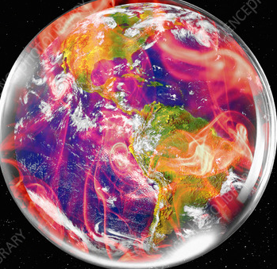
Q5. Answer
In what ways can understanding natural variability help us plan for extreme weather events?
Recognising recurring patterns in natural variability, such as ENSO, improves the prediction of extreme weather events like floods, droughts, and heatwaves.
Understanding these patterns increases the reliability of seasonal climate forecasts, allowing governments and communities to prepare for weather-related hazards driven by natural variability.
Knowledge of long-term natural variability supports the design of resilient infrastructure by accounting for historically observed extremes rather than short-term averages alone.
Records of past climate variability help assess the likelihood of compound extreme events, such as coincident heatwaves and droughts, which have occurred under natural climate fluctuations.
Understanding the limits of predictability in natural systems informs emergency planning by clarifying where forecasts are reliable and where uncertainty and risk remain high.
Considering the timescales of natural variability is essential, as short-term processes (e.g. ENSO or the 11-year solar cycle) influence near-future extremes, whereas long-term drivers (e.g. Milankovitch cycles) operate over 10s of thousands of years and provide background climate context rather than direct forecasting value.

Slide 14
Q6.
Discuss the significance of Milankovitch cycles in shaping Earth's glacial and interglacial periods.

Slide 15
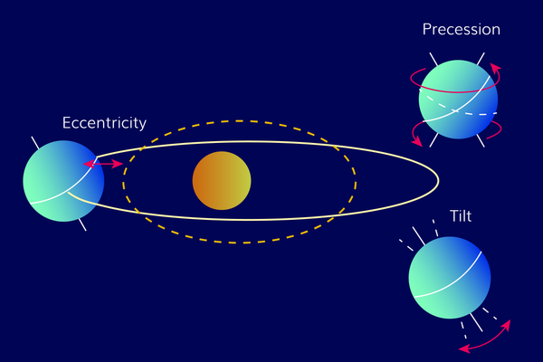
Q6. Answer
Discuss the significance of Milankovitch cycles in shaping Earth's glacial and interglacial periods.
Orbital eccentricity alters the shape of Earth’s orbit, changing how solar radiation is distributed through the year, over ~100,000-year timescales.
Obliquity controls the contrast between seasons by redistributing incoming solar radiation between low and high latitudes, influencing the growth and decay of ice sheets.
Precession changes the timing of the seasons relative to Earth’s position in its orbit, altering the seasonal distribution of solar radiation without changing the global annual mean.
The interaction of these orbital cycles modifies the amount, distribution, and seasonality of incoming solar radiation, driving long-term climate variability, including glacial cycles. Energy inputs can vary by as much as 25%.
Milankovitch cycles act as a trigger, with relatively small changes in energy inputs amplified by feedbacks such as ice/albedo effects and changes in atmospheric CO₂, producing large global temperature changes. Feedbacks are key and will be discussed more in later lectures.

Slide 16
Q7.
Can natural variability explain observed trends in global warming? Why or why not?

Slide 17
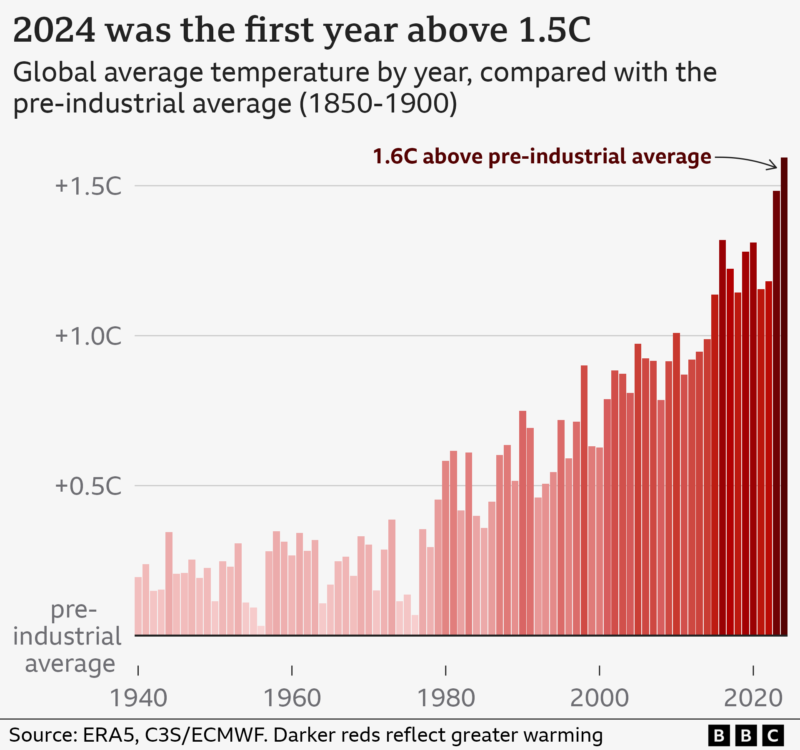
Q7. Answer
Can natural variability explain observed trends in global warming? Why or why not?
Natural variability can cause short-term fluctuations (e.g. solar inputs/ENSO) but cannot account for the sustained long-term warming trend observed in recent decades.
The dominant driver of the current global warming trend is anthropogenic greenhouse gas emissions, which create a persistent energy imbalance (we will learn exactly why next week!)
Studies using fingerprinting techniques with added process understanding have shown that the observed warming patterns cannot be explained by natural variability alone.
Evidence from historical records reveals no precedent for the rapid warming seen over the last century.
Although natural variability modulates short-term trends, the overall trajectory is dominated by human influence.
This is not a 100% complete answer – what more reasons can you think of?

Slide 18
Q8.
How might future changes in natural variability interact with anthropogenic climate change to influence global climates? climates?

Slide 19
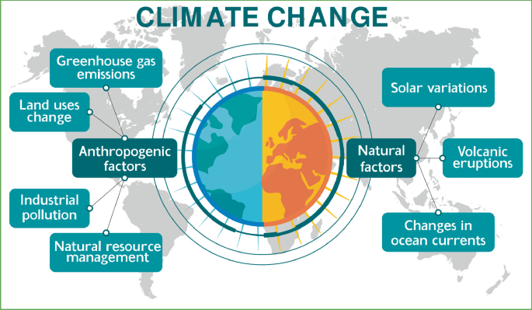
Q8. Answer
How might future changes in natural variability interact with anthropogenic climate change to influence global climates?
Variability in systems like ENSO could intensify extreme weather events in a warming world.
Changes in ocean circulation patterns may either exacerbate or moderate regional warming, depending on associated feedbacks.
Large volcanic eruptions could temporarily offset warming by injecting reflective aerosols into the stratosphere.
Shifts in natural variability may increase uncertainty in climate projections, complicating long-term planning.
Interactions between human influence and natural variability could result in non-linear climate responses, leading to unexpected regional or global outcomes.

Slide 20
Q9.
Compare the climatic influence of solar variability and volcanic eruptions. How do their impacts differ in duration and magnitude?

Slide 21
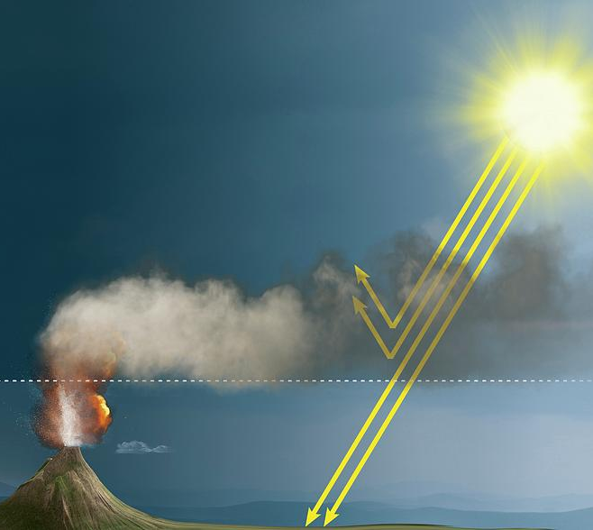
Q9. Answer
Compare the climatic influence of solar variability and volcanic eruptions. How do their impacts differ in duration and magnitude?
Solar variability
  Involves natural changes in the Sun’s energy output, such as the 11-year sunspot cycle.
  Changes in total solar irradiance are very small (about 0.1%).
  Leads to minor temperature changes, typically around 0.01 °C.
  Effects occur over decadal timescales and do not explain recent global warming.
  Since the mid-20th century, solar output has shown no increasing trend, while temperatures have risen.
Volcanic eruptions
  Large eruptions inject sulphur dioxide into the stratosphere, forming sulphate aerosols.
  These aerosols reflect incoming solar radiation, causing global cooling.
  Cooling can reach several tenths of a degree Celsius.
  Effects are short-term, typically lasting 1–3 years.
  A single eruption causes temporary cooling; multiple eruptions would be needed for longer-lasting effects.
Key comparison:
  Solar variability has a small, long-term influence, while volcanic eruptions cause larger but short-lived climate impacts.

Slide 22
Q10.
Why can’t natural climate drivers explain the observed warming since the mid-20th century?

Slide 23
Q10. Answer
Why can’t natural climate drivers explain the observed warming since the mid-20th century?
Natural climate drivers (solar variability, volcanic activity, orbital changes, and ocean circulation) cause short-term or long-term fluctuations, not sustained warming.
Solar output has shown no increasing trend since the mid-20th century, while global temperatures have risen rapidly. If the Sun were causing warming, we would expect warming throughout the atmosphere, but observations show surface warming and stratospheric cooling, which is a greenhouse gas signature.
Volcanic eruptions cause short-term cooling, not long-term warming.
Orbital (Milankovitch) cycles operate over thousands to tens of thousands of years, far too slowly to explain recent warming.
The magnitude and rate of modern warming are much larger and faster than those seen in natural variability alone.
Observations and climate models show that anthropogenic greenhouse gas emissions dominate recent warming.
Key conclusion:
Natural variability can explain short-term fluctuations, but human-driven greenhouse gas emissions are responsible for the sustained warming seen over the last 150 years.

